Slide 1

GREAT GIFT IDEA
Engravable
Cutting Boards

Slide 2


Slide 3
How to Make
Engravable Gift Boards
WHAT DO I NEED:
Maple Boards - Recommended for Best Results
Howard Food Grade Mineral Oil
Wooster 2” inch Brush

Slide 4
How to Make
Great Boards
BEST PROCEDURE:
Spread Howard Oil & Coat Both Sides of Board Evenly with Brush
Run your Standard Wood Setting on your Engraving Machine
Best Practice: 50 Watts - 40 Speed and Power 100

Slide 5
Where Can I Get
Everything
BOARDS:
www.boards4engraving.com has the Best Maple Boards
11x14 Maple Board & Walnut Trim (Case of 5) $105 plus Shipping
JDS and other Awards Suppliers have Many Shapes and Options
OIL & BRUSHES:
Wooster Foam King Paintbrush 2inch: $3.00 or $4.00
Howard Food Grade Mineral Oil for Wood Cutting: $10.00 or $15.00

Slide 6
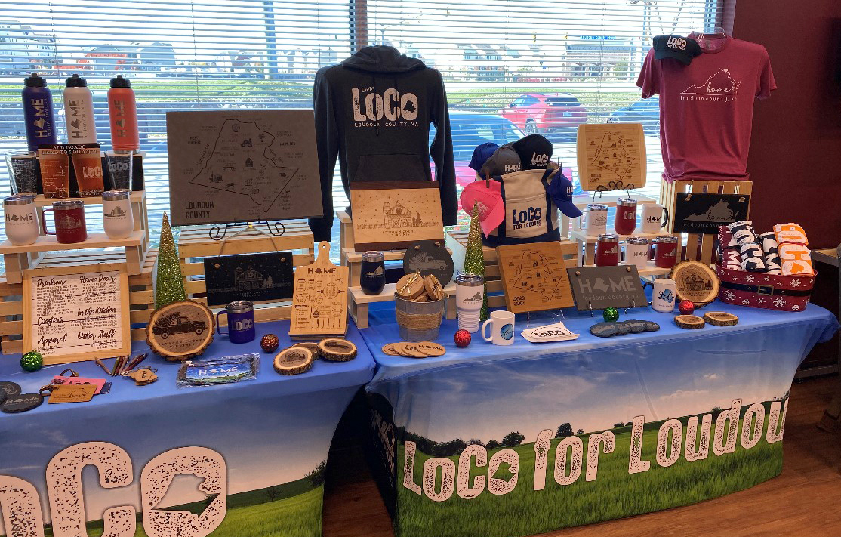
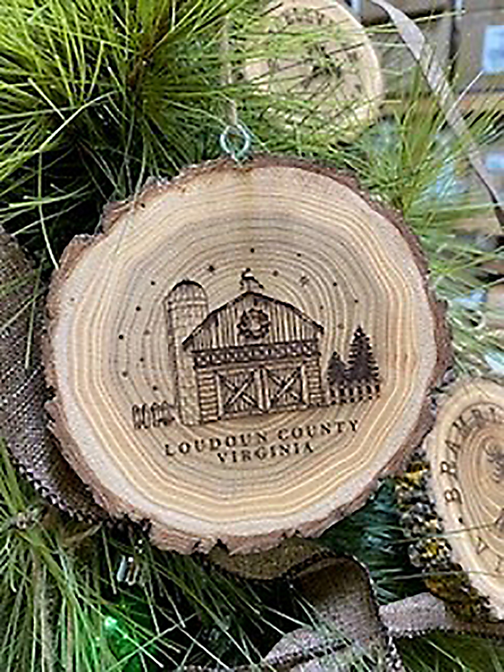
More Great Engravable
Gift Ideas

